Slide 1

t-SNE Project Overview
Erika von Kirchbach

Slide 2
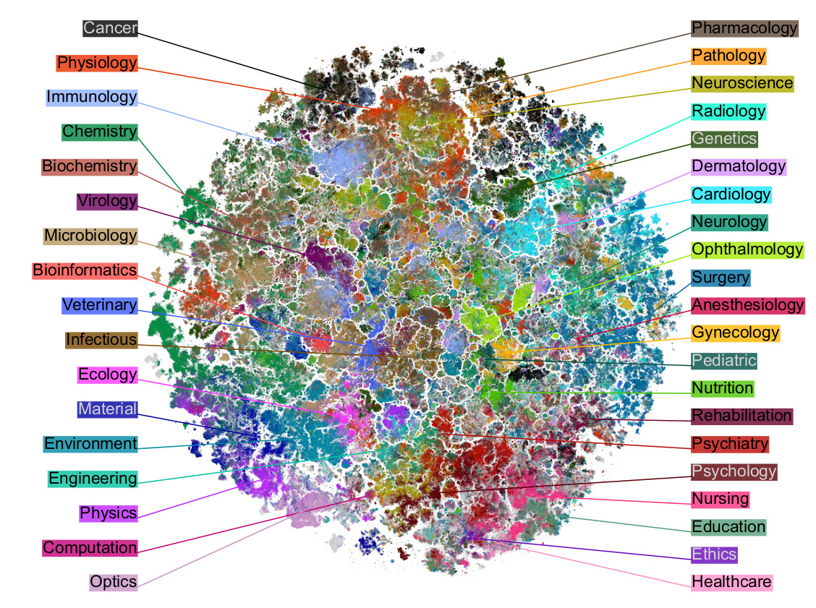
PURPOSE
This project will help to visualize thousands of documents and their inter-document relationships and any possible hidden trends.
Due to the use of entity extraction, filtering can be done that allows this project to be used across many departments.
PubMed’s public version that graphs publications based on biomedical terms
Link to interactive site

Slide 3
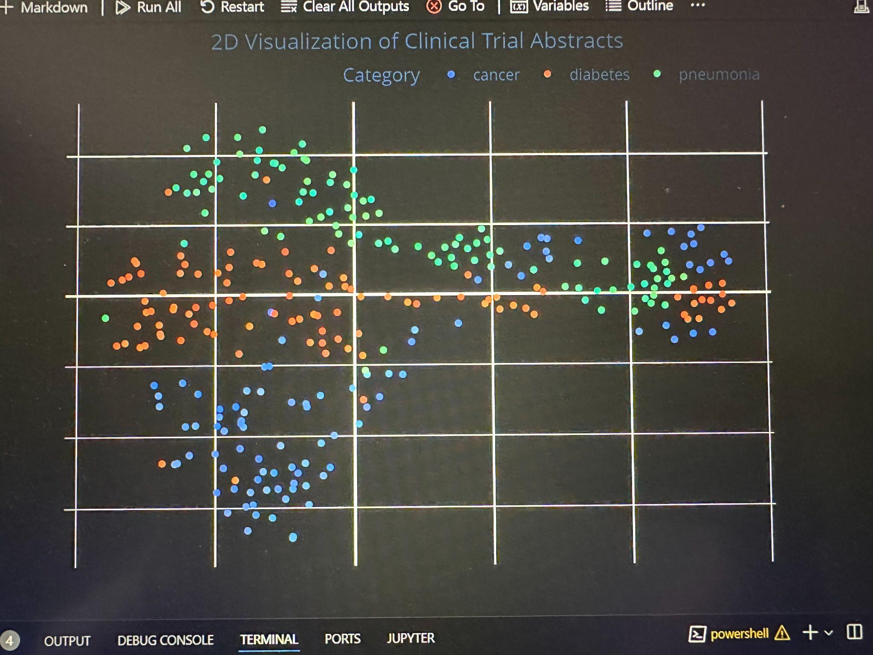
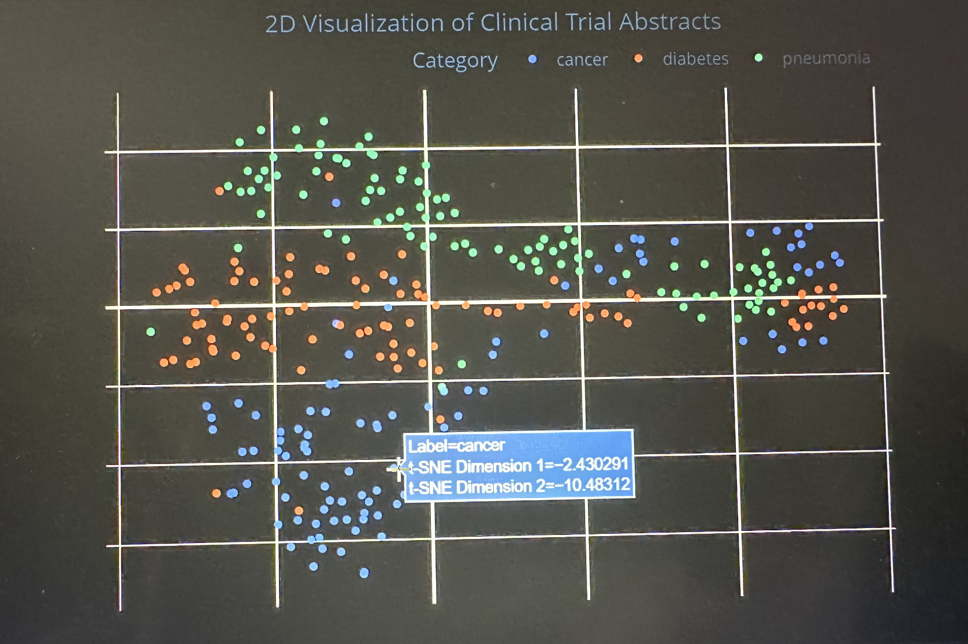
PFIZER’S VERSION
Python, Jupyter notebooks, VSCode
Data accessibility problem
Proof of concept
Indexing for interactions

Slide 4
USE CASES
01 Strategy
02 Indication
expansion
03 More
By mapping all of Pfizer’s documents, we can overlay the visualization with PubMed’s to see what the industry vs. Pfizer is focused on, which could help make strategic decisions for Pfizer’s future projects.
We can map various drugs and diseases to help researchers discover more and dive deeper into indication expansion, studying how already-made drugs can be used for other diseases.
Because the entity extraction can be filtered, various departments here at Pfizer can easily choose their own keywords to map their documents based on many different aspects that are up to the user.

Slide 5
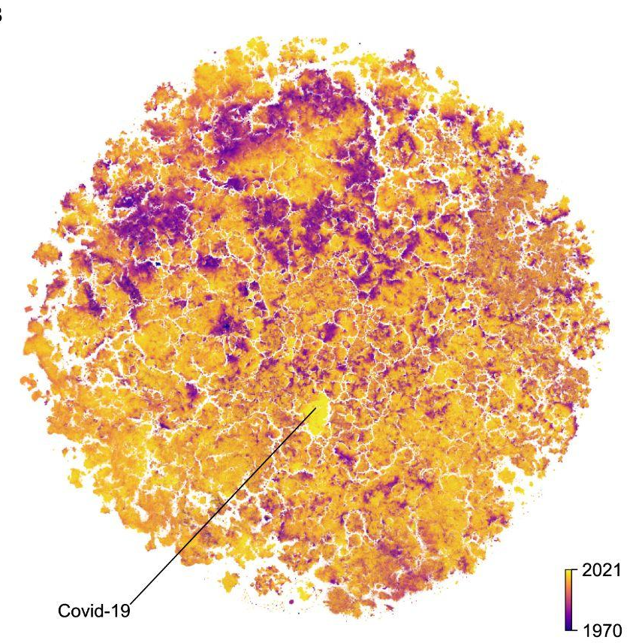
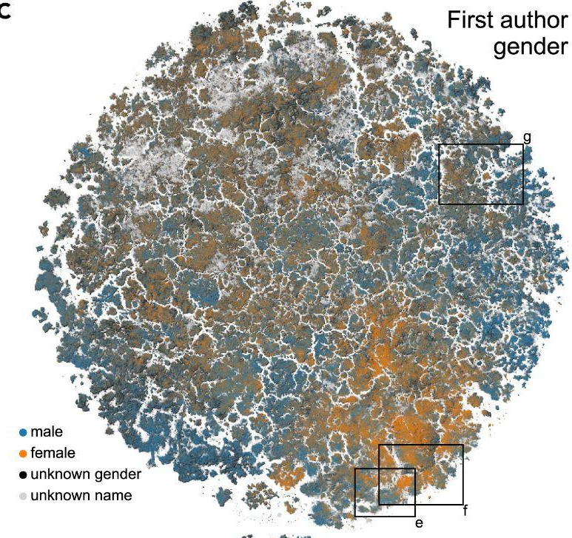
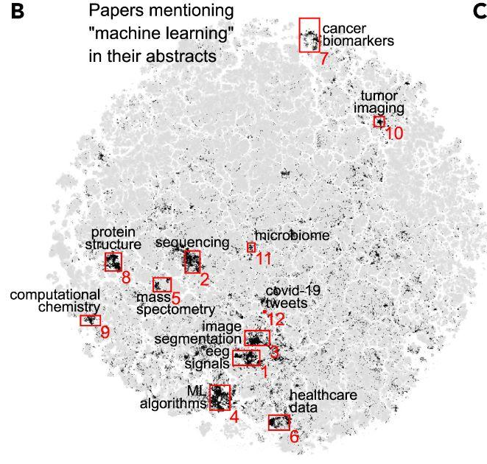
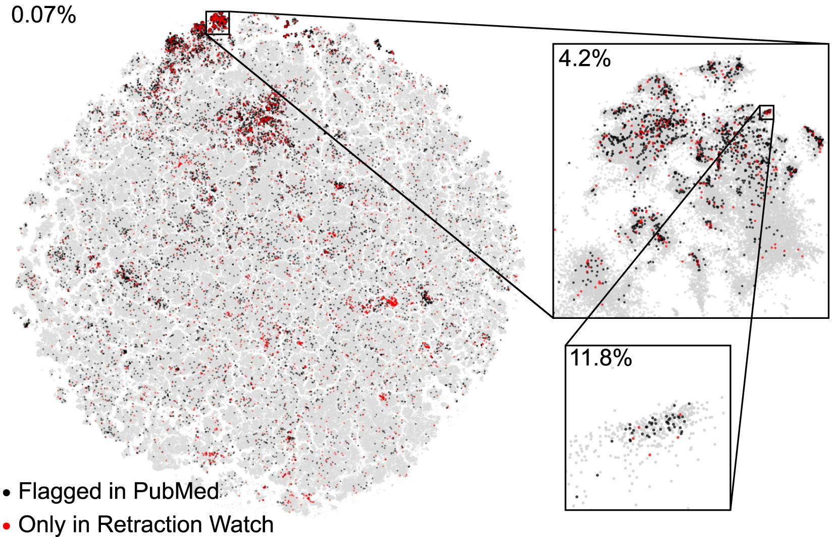
PUBMED’S OTHER USE CASES
Fraudulent publications
Covid publications
Gender bias
Machine learning

Slide 6
PIPELINE OVERVIEW
01
Entity Extraction
02
Unstructured user interface
03
Embeddings
04
t-SNE visualization
05
Scale t-SNE
Using the Unstructured library and Metamap and it’s API, we were able to recognize biomedical terms from all sorts of types of documents from Pfizer’s data lakes.
Using Streamlit, we are in the process of creating a user interface where users can upload any document and easily convert it to text while extracting various entities.
With pubmedBERT, we embedded the text from the Unstructured code into vectors, to later use for the t-SNE visualizations.
Using t-SNE, we were able to visualize documents based on the extracted key word in a 2D manner.
We are in the process of scaling our t-SNE visualizations using Pfizer and Seagen’s internal documents for relationship and trend analysis purposes.
Currently working on this
Currently working on this

Slide 7
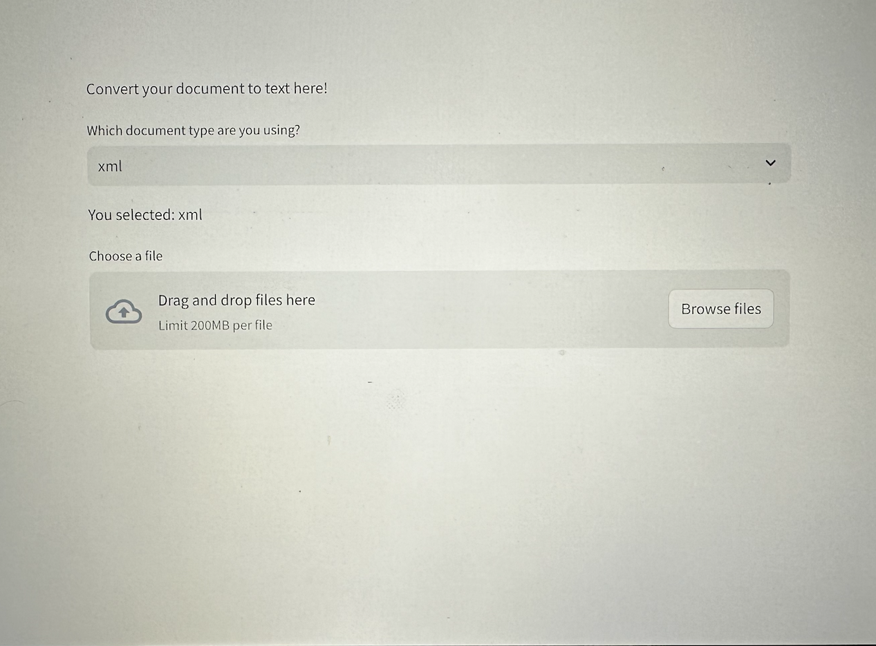
MORE ON UNSTRUCTURED + UI
• PDF (w/ images and tables etc.)
• TXT
• DOCX
• DOC
• CSV
• TSV
• XLSX
• XML
• PPTX
• PPT
• EPUB
• HTML
• JPG
• JPEG
• JSON
• HEIC
• PNG
• MSG
• ODT
• TIFF
• MD
• TXT

Slide 8
THANK YOU + QUESTIONS?
A special thanks to Franklin Fuchs and Syed Hoque and the Digital team!

